Slide 1
Assignment briefing
SEPTEMBER 18, 2018

Slide 2
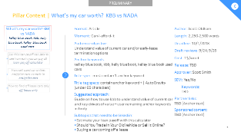
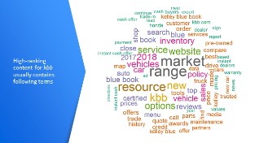
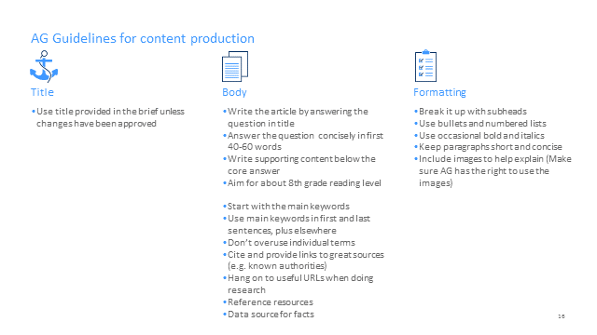
Important | Content of this briefing package
      Assignment briefing
      Inspirational word cloud
      AG Guidelines
Contains keywords to use, title, deadlines, content we want to beat etc.
Note: there's a section for "Subtopics that need to be linked in article". Those are the titles of other articles that need to be linked into your main article. The tree on the left side explains this relationship.
Shows the content of articles that tend to do well on Google for your given keyword. This is meant to be just a thought starter.
Guidelines on title, body and formatting
Please read carefully

Slide 3
Subtopic | What's the average miles driven per year?
C
Format: Article
Moment: Am-I-getting-a-deal
Audience objective: Understand lease terms and technicalities
Question(s) article has to answer: What's the national average miles driven per year, how do you calculate miles driven per year, is a high-mileage lease right for you
Anchor keywords: average miles driven per year
Title spec: must contain anchor keyword
Title tag specs: contain anchor keyword + | AutoGravity (under 65 characters)
Suggested approach: Provide different examples of average miles driven per year given distance from work and other factors to consider, finally explain how to calculate that number based on one's unique circumstances. Please use official DMV stats where possible.
Author: Lynn Walford
Length: 1,250-1,500 words
Deadline: 10/05/2018
Draft Reviews: 9/28; 10/03
Cost: 0.75$/word
Release: 10/15/2018
Approver: Scott Smith
Content we want to beat: https://www.immihelp.com/newcomer/used-car-buying-tips.html https://www.carinsurance.com/Articles/average-miles-driven-per-year-by-state.aspx https://www.fhwa.dot.gov/ohim/onh00/bar8.htm https://www.fool.com/investing/general/2015/01/25/the-average-american-drives-this-much-each-year-ho.aspx https://www.directline.com/car-cover/annual-mileage-calculator
      What's GAP insurance? A guide to car leasing terms
      gap insurance
      What's the msrp meaning?
      Msrp meaning
      What's the average miles driven per year?
      Average miles driven per year
      How to compare car loan rates
      car loans, car loan rates, car loan interest rates, best auto loan rates
      What is the best auto financing?
      auto financing
Plus deep-dive for each lender

Slide 4

High-ranking content for average miles driven per year usually contains following terms

Slide 5
AG Guidelines for content production
      Title
      Body
      Formatting
  Use title provided in the brief unless changes have been approved
  For questions to answer, ask or state each in a subtitle or single line
  Next, answer the question concisely in 40-60 words
  Write content to support that below the core answer
  Aim for about 8th grade reading level
  Start with the main keywords
  Use main keywords in first and last sentences, plus elsewhere
  Don’t overuse individual terms
  Hang on to useful URLs during research
  Cite and provide links to great sources (e.g. known authorities)
  Reference resources
  Reference the data source for facts
  Break it up with subheads
  Use bullets and numbered lists
  Use occasional bold and italics
  Keep paragraphs short and concise
  Include images to help explain (Make sure AG has the right to use the images)
  If custom graphics or diagrams are needed, describe those

